Slide 1
Sleep Analysis
Team: Megan, Misty, Jordan, Laura, Danny

Slide 2
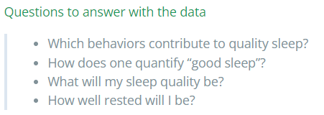
Overview
Notes:
This project analyzes sleep data collected from Sleep Cycle iOS App on Kaggle in order to determine what contributes to good sleep. Factors examined are caffeine consumption, physical activity, heart rate, and length of time sleeping. We will use machine learning models to predict if a person will have good or poor sleep based on these factors.

Slide 3
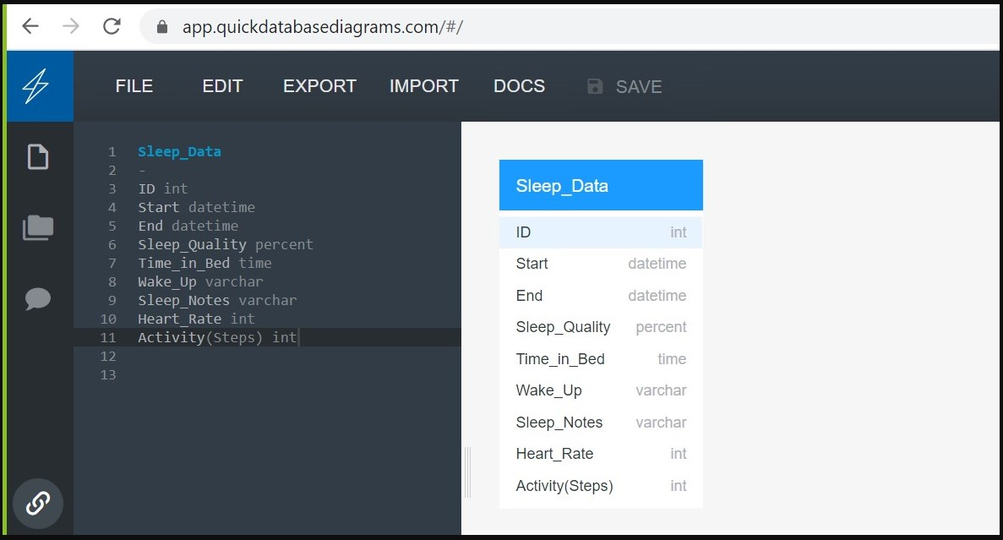
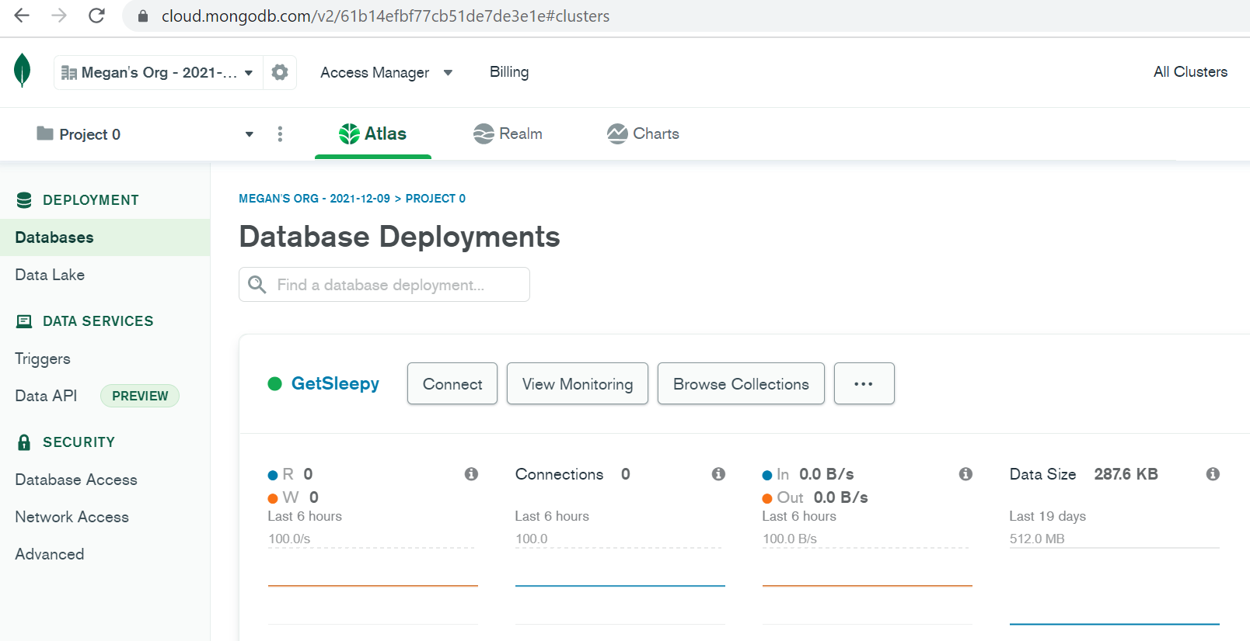
Database
Free
Simple
High Speed
Flexible
Notes:
Initially, we talked about using other database web applications. However due to the potential cost and our desire to use free applications, we selected MongoDB Atlas and Compass to store and connect to our dataset

Slide 4
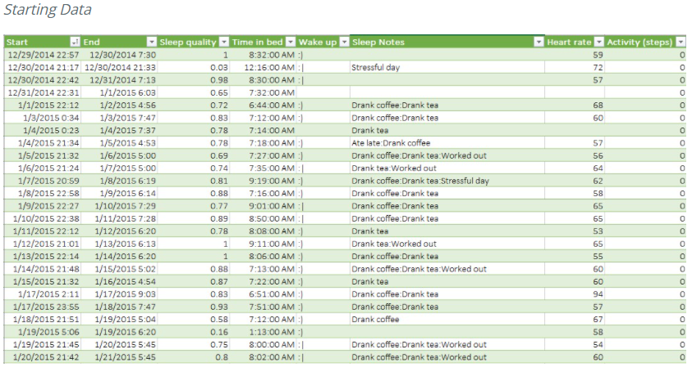
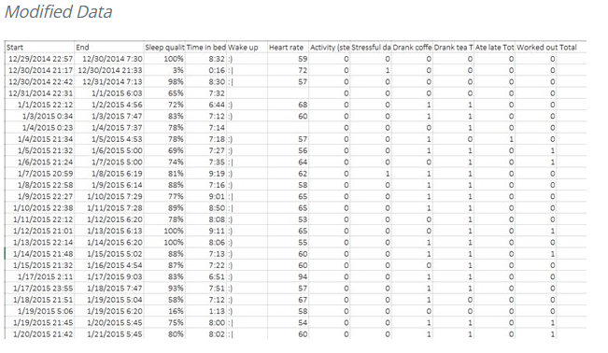
Data discovery and selection
Original Kaggle Data Set - Sleep Cycle iOS App
Notes:
Initially, we looked for topics of interest on Kaggle to see the data that was available. We came upon the sleep data of an individual who tracked his/her sleep patterns for just over 3 years. The dataset started with 8 columns, one of which was titled “Sleep Notes” and had several features in it. Part of the initial clean up of this data was to break those out to separate columns.

Slide 5
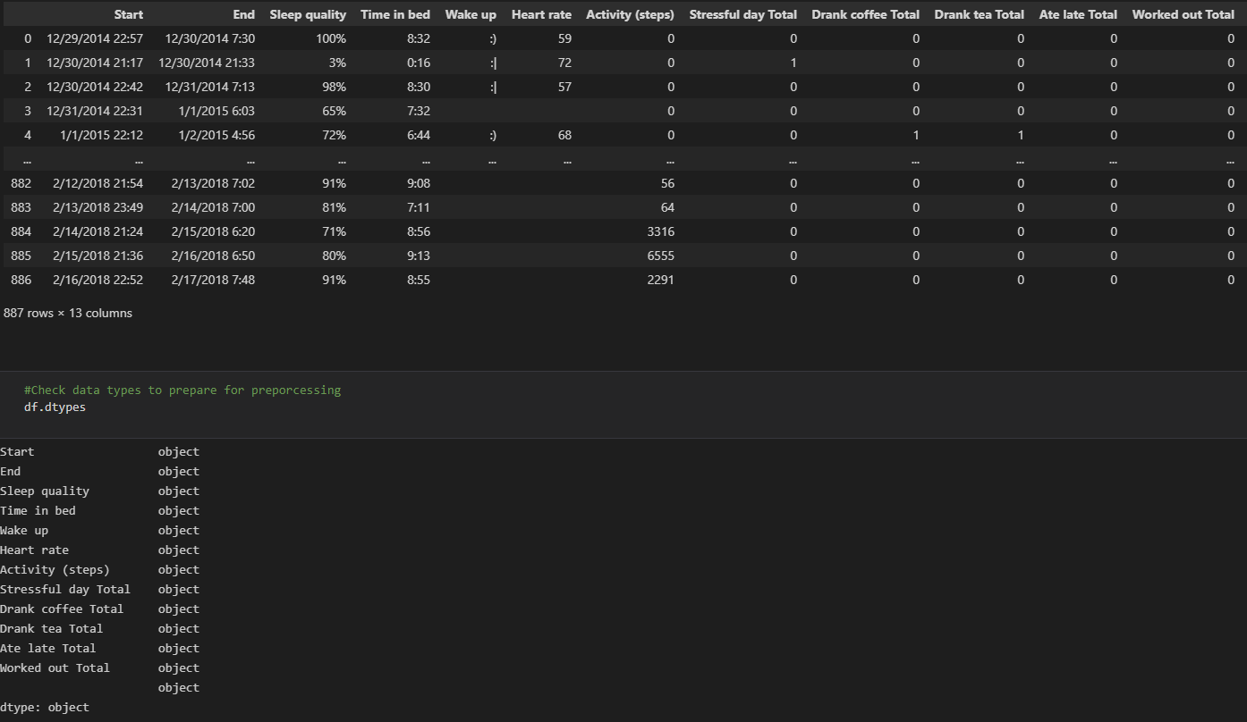
Data Cleaning

Slide 6
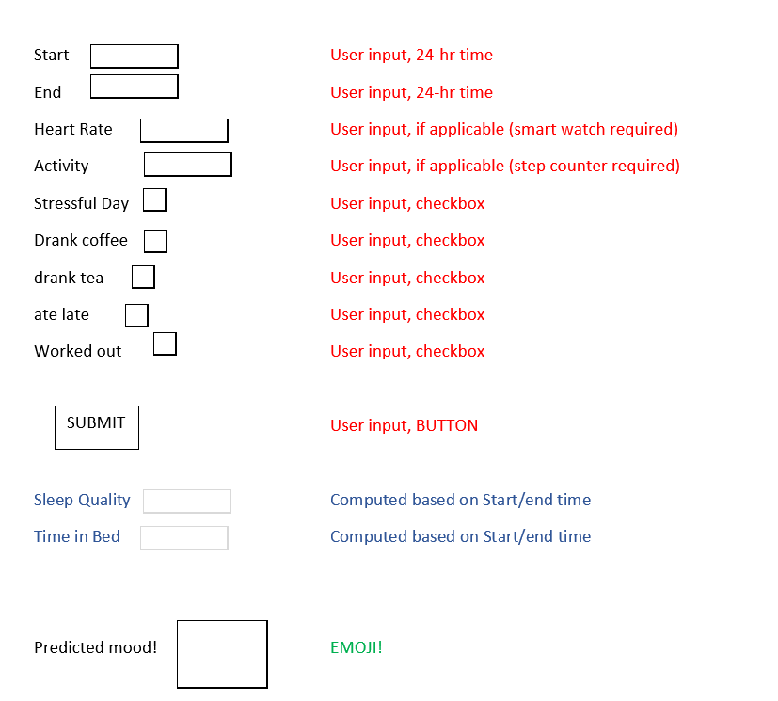

Emoji Estimator
Notes:
Preliminarily, the data preprocessing and cleaning reduced our dataset to 162 useable data points. Then the plan was to try to predict what emoji would result. Based on this initial plan, a classifier model was selected for our Machine Learning Model. Once this initial model was run, we determined that the useable data was not enough and using a classifier machine learning model was not appropriate.

Slide 7
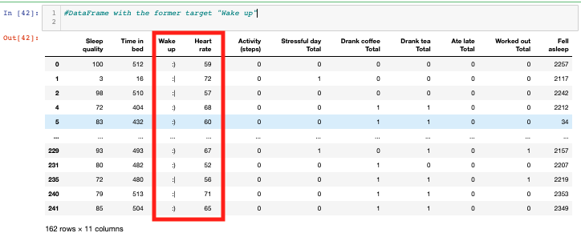
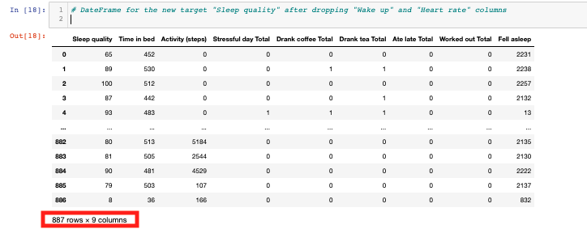
Pivot Direction
Notes:
We decided to make our target the Sleep Quality feature as it has more outcomes to predict. This change in plan required more preprocessing. A df_tranformed.csv has been generated where all features are in the form of a 1 or 0, allowing for model functionality and keeping 887 complete rows of data.

Slide 8
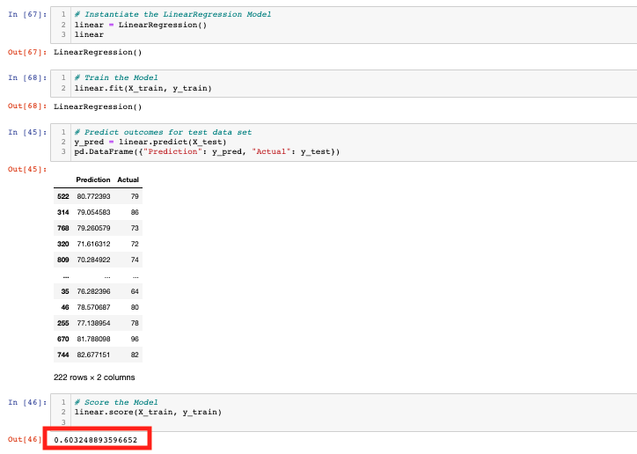
Linear Regression Model

Slide 9
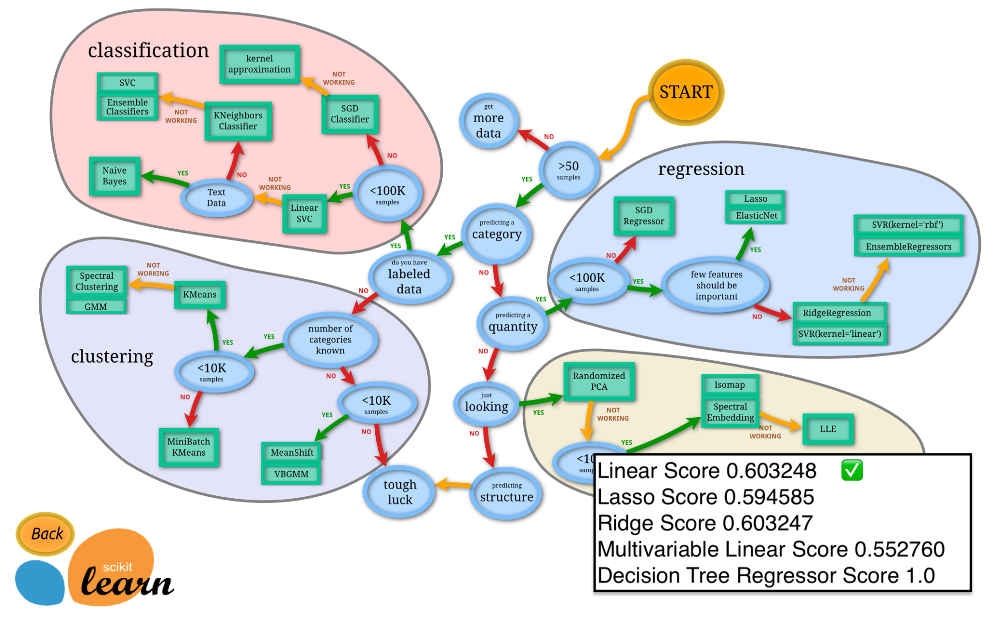
Model Testing

Slide 10
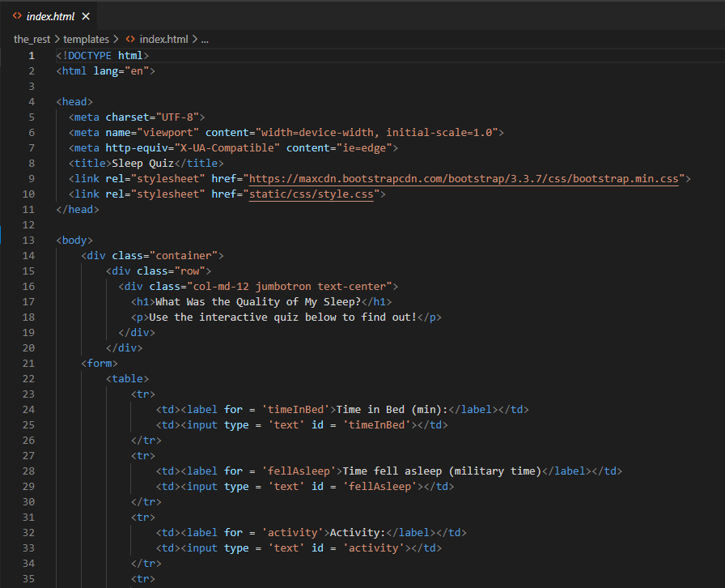
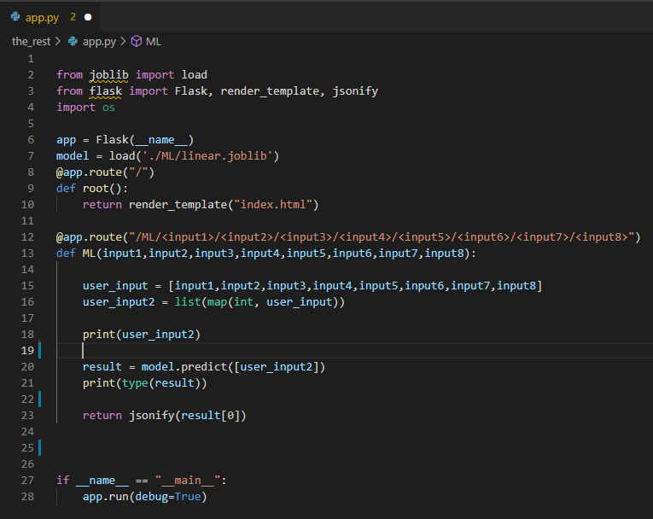
Flask Assembly
Notes:
HTML screenshot / Flask

Slide 11
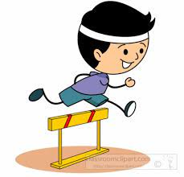


Project Challenges
Notes:
Dataset shortcomings (only 887 rows of data, a lot of those rows had NaN or blank fields)
If initial data set was larger, losing some of the rows would not have been as impactful.
Issues with casting user inputs to integers
Getting a high accuracy model
Shaping of variables

Slide 12
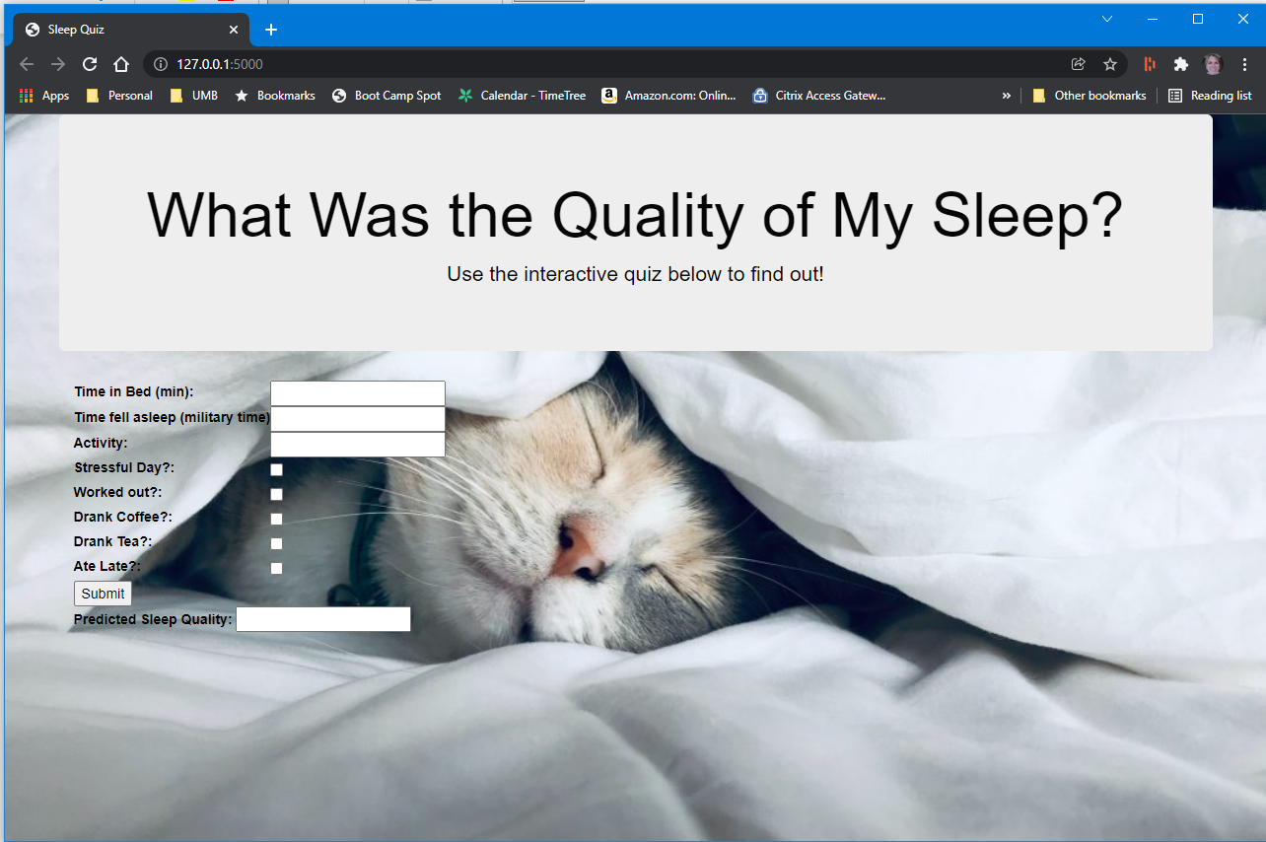
Final Product
Finished Model
Web Page
Dashboard
Tableau Visualizations
Wake Up
Sleep Notes
Activity
Time in Bed
Heart Rate
Improvement Ideas:
Save user inputs and retrain model as more data is gathered.
Format user inputs to adhere to needed numbers or trigger an error.
Suggest ways to improve sleep quality
Build marketing database of users for various sponsors.

